Slide 1


sAIns-digital ” Digitalizing the Laboratory, Bridging the Gap with IoT Integration “
( Hackathon Theme: Building Intelligent Products and Platforms )
Danny Ismarianto Ruhiyat ( info@danito.net )

Slide 2
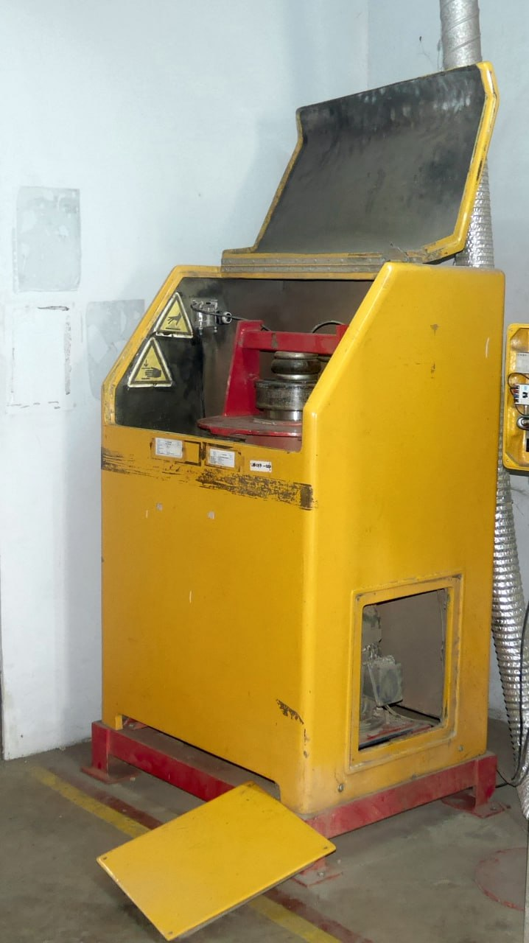
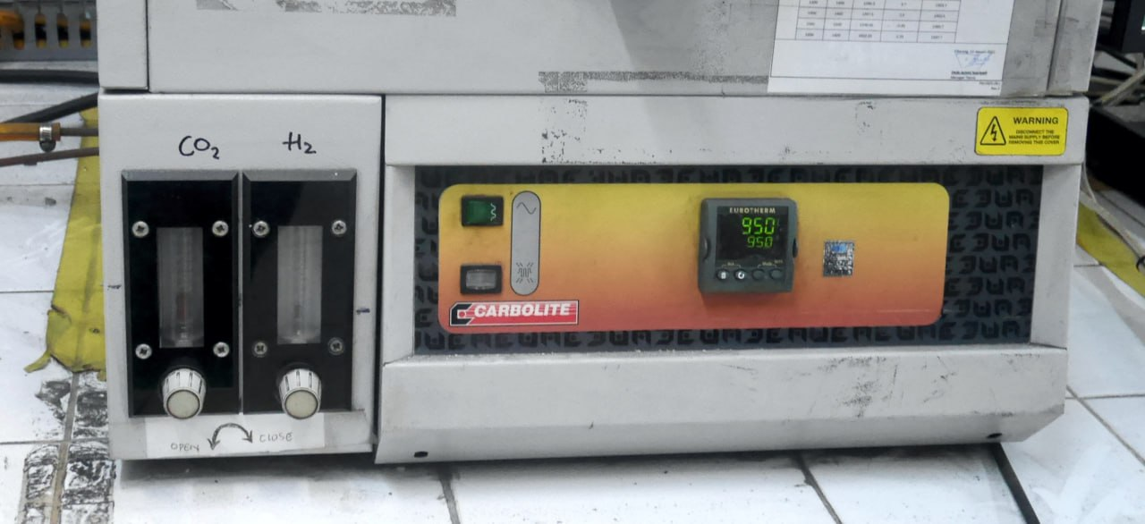
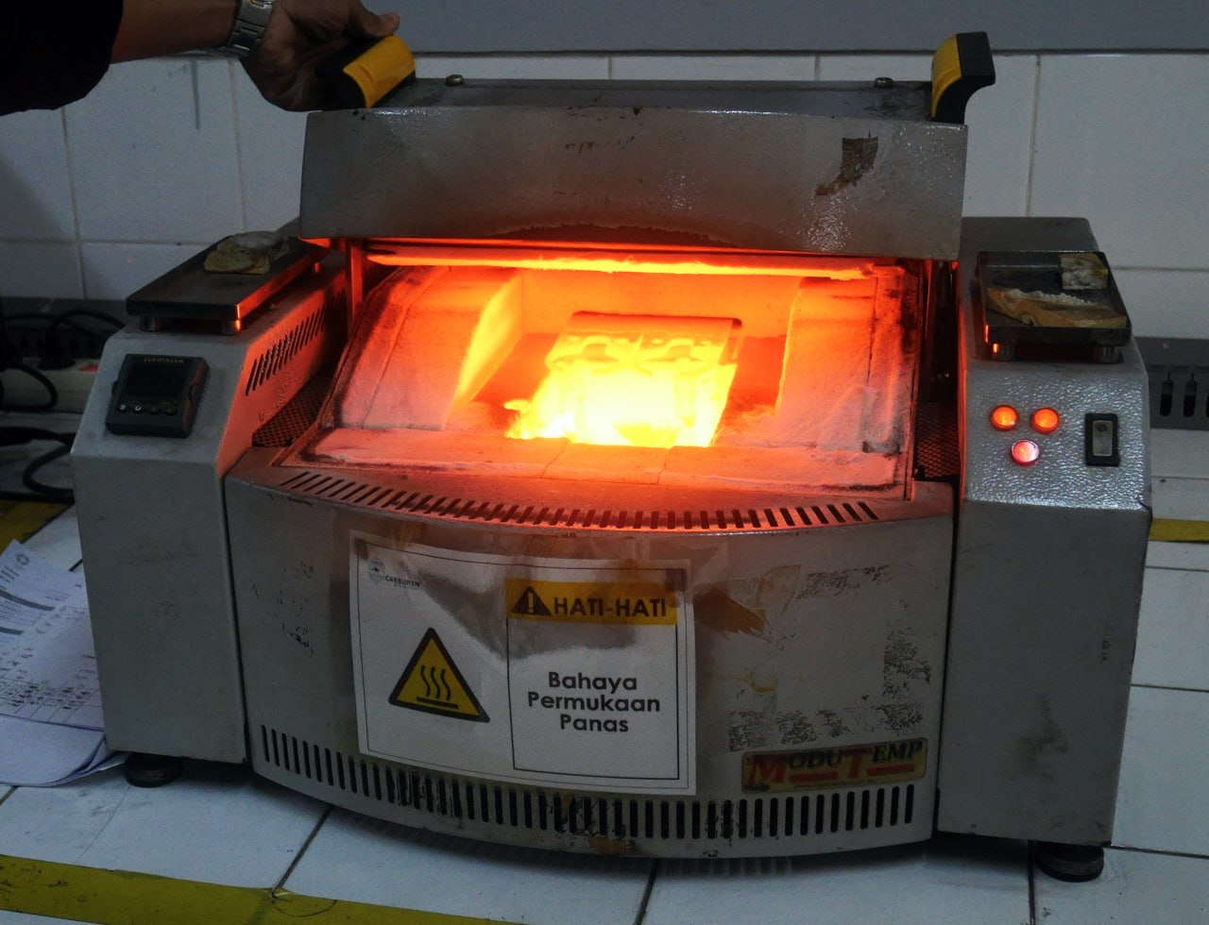
1. Problem Statement
The existence of laboratories play a vital role in research, but many are still reliant on manual data entry and outdated processes, hindering efficiency and collaboration
Conventional laboratory instruments often lack connectivity (they don’t have output at all) , making data collection and analysis cumbersome and time-consuming
CYIENT - CYIENTIFIQ INNOVATION LEAGUE GLOBAL HACKATHON 2023
sAIns-digital : “Digitalizing the Laboratory, Bridging the Gap with IoT Integration” | Danny Ismarianto Ruhiyat ( info@danito.net )
01

Slide 3
2. Solution Overview
The word “science“ in Bahasa Indonesia is “sains“ (literally, there is an “AI“ in it). sAIns-digital provide Artificial Intelligence based solutions, using Computer Vision technology to imitate the human eye's function in seeing the instrument output and automatically send the output data (without having to write by hand on paper or type on a keyboard)
sAIns-digital is a breakthrough solution that enables every laboratory instruments, even conventional ones, to seamlessly transmit data via Internet of Things (IoT)
Collaboration between:
Microprocessor: Raspberry Pi / Google Coral Dev Board / BeagleBone Black
Microcontroller: ESP8266 / ESP32 / RP2040
Sensors / Actuators: Temperature, Humidity, Pressure, Accelerometer, Gyro, Motors, LEDs, etc.
Software: Linux OS, C/C++, Bash, Python
CYIENT - CYIENTIFIQ INNOVATION LEAGUE GLOBAL HACKATHON 2023
sAIns-digital : “Digitalizing the Laboratory, Bridging the Gap with IoT Integration” | Danny Ismarianto Ruhiyat ( info@danito.net )
02

Slide 4
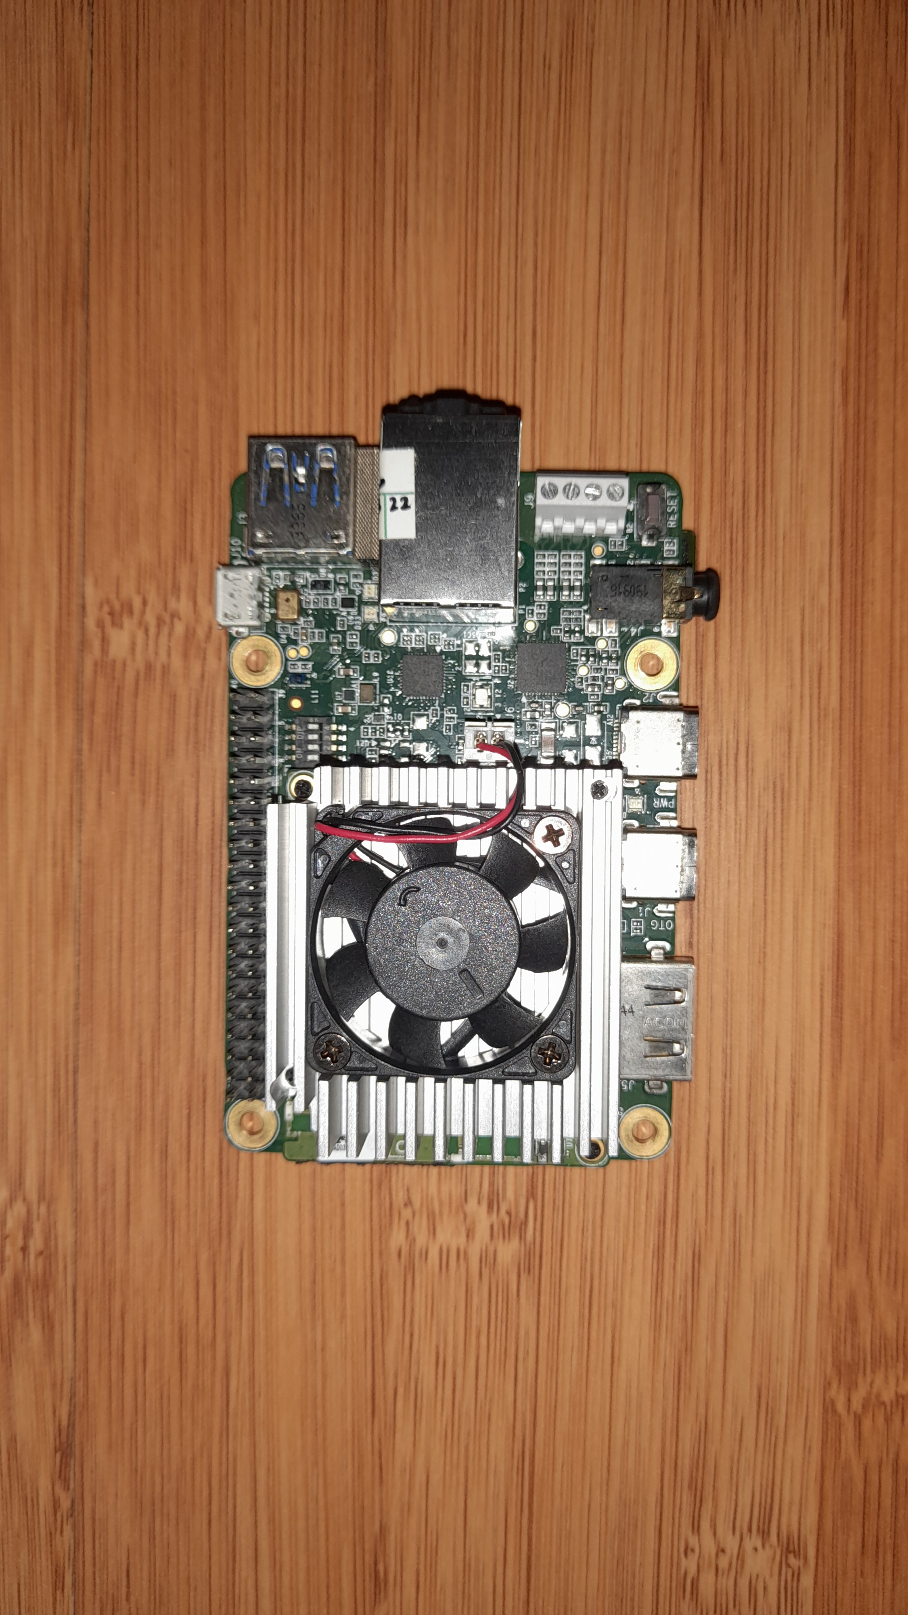
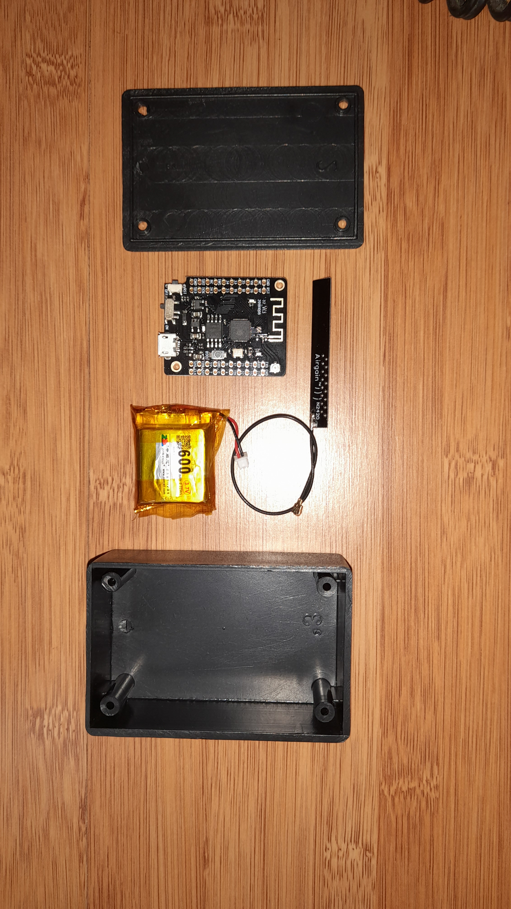
MicroProcessor & MicroController
CYIENT - CYIENTIFIQ INNOVATION LEAGUE GLOBAL HACKATHON 2023
sAIns-digital : “Digitalizing the Laboratory, Bridging the Gap with IoT Integration” | Danny Ismarianto Ruhiyat ( info@danito.net )
03

Slide 5
3. Value Proposition
sAIns-digital will revolutionizes laboratory operations, improving data accuracy, and streamlining research processes
Benefits:
Will reduce data entry errors
Accelerated research with real-time data access
Enhanced collaboration through shared data repositories
CYIENT - CYIENTIFIQ INNOVATION LEAGUE GLOBAL HACKATHON 2023
sAIns-digital : “Digitalizing the Laboratory, Bridging the Gap with IoT Integration” | Danny Ismarianto Ruhiyat ( info@danito.net )
04

Slide 6
4. Unique and Feasible
Implementation:
The sAIns-digital device easily attach to lab instruments
Seamless integration with cloud platforms for data storage and analysis
Differentiator:
sAIns-digital is the first universal IoT solution for laboratories, bridging the gap between conventional and modern instrumentation
Cost-effective and user-friendly, sAIns-digital sets a new industry standard
Unique Aspects:
Universal compatibility with existing lab equipment
Real-time data transfer to cloud-based platforms
Integration with data analytics tools for instant insights
CYIENT - CYIENTIFIQ INNOVATION LEAGUE GLOBAL HACKATHON 2023
sAIns-digital : “Digitalizing the Laboratory, Bridging the Gap with IoT Integration” | Danny Ismarianto Ruhiyat ( info@danito.net )
05

Slide 7
5. Impact and Sustainability
Impact:
Significant reduction in paper usage and waste
Accelerated research leads to faster discoveries
Enhanced data-driven decision-making in laboratory operations
Sustainability:
Reduced environmental impact through paperless data collection
Ongoing data analysis leads to resource-efficient processes
CYIENT - CYIENTIFIQ INNOVATION LEAGUE GLOBAL HACKATHON 2023
sAIns-digital : “Digitalizing the Laboratory, Bridging the Gap with IoT Integration” | Danny Ismarianto Ruhiyat ( info@danito.net )
06

Slide 8
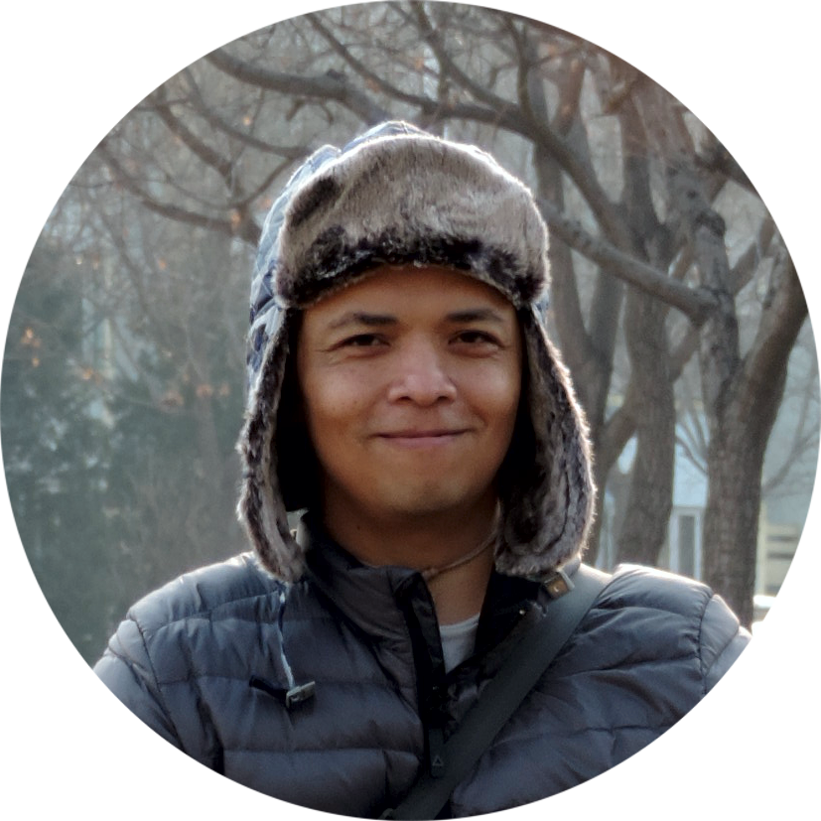
6. Meet sAIns-digital Team ...
Meet Danny Ismarianto Ruhiyat a.k.a danito the solo fighter in sAIns-digital team as an AIoT Engineer
More than 3 years experience in Vision Computing
More than 7 years experience in Internet of Things
Has won various national and international hackathons
Currently working as IoT Tech Lead at one of the largest logistics companies in Indonesia
Has studied Chemistry and IT majors (quite familiar with the science laboratory and its instruments)
https://www.linkedin.com/in/dannydanito/
https://www.instagram.com/danito_net/
CYIENT - CYIENTIFIQ INNOVATION LEAGUE GLOBAL HACKATHON 2023
Danny Ismarianto Ruhiyat
AIoT Engineer
sAIns-digital : “Digitalizing the Laboratory, Bridging the Gap with IoT Integration” | Danny Ismarianto Ruhiyat ( info@danito.net )
07

